Slide 1
AutoStart program in Windows

Slide 2
AutoStart program is used for starting some app while turning on computer. For this you need select apps which you want from settings. After this, these programs will always open after turning on computer till you remove autostarting.

Slide 3
How to select app for automatically startup in windows
Select the Start button and scroll to find the app you want to run at startup.
Right-click the app, select More, and then select Open file location. This opens the location where the shortcut to the app is saved. If there isn't an option for Open file location, it means the app can't run at startup.
With the file location open, press the Windows logo key + R, type shell: startup, then select OK. This opens the Startup folder.
Copy and paste the shortcut to the app from the file location to the Startup folder.

Slide 4
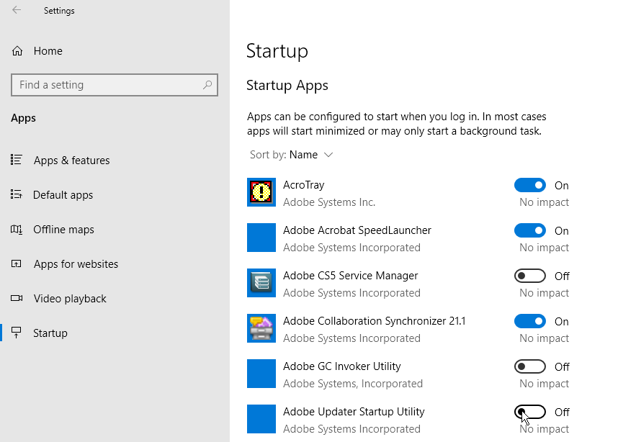
Disable Startup Apps in Windows Settings
Go to Settings > Apps > Startup to view a list of all apps that can start up automatically and determine which should be disabled. You can sort the list by name, status, or startup impact. A switch next to each app indicates a status of On or Off to tell you whether or not that app is currently in your startup routine. To disable an app, turn off its switch.

